Slide 1
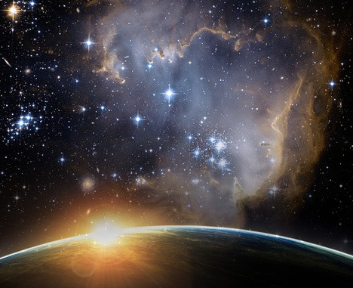
The Universe

Slide 2
The universe is a term\word that describes everything that has matter and energy.
Matter is anything that has mass and consists out of area.
An example of matter is planets, sun and a table etc.
Energy comes from the sun in the form of light and warmth. There is also human made energy sources.

Slide 3
OUR ADDRESS
THE SCHOOL’S
THE UNIVERSE
FIRST AVENUE
THERESAPARK
PTA NORTH
PRETORIA
GAUTENG
SOUTH AFRICA
AFRICA
EARTH
OUR SOLAR SYSTEM
MILLIONS OF OTHER SOLAR SYSTEMS
MILKY WAY
MILLIONS OF OTHER GALAXIES
UNIVERSE

Slide 4
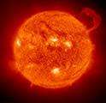
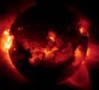

Slide 5
How did the universe begin.
Scientific and faith theories
Scientific=big bang theory.
Faith= God created everything in 6 days.
Universe consists out of millions of galaxies.
Our galaxy is known as the milky way.
Every galaxy has millions of solar systems.
WYS ENCARTA

Slide 6
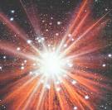
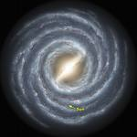
SKALE / SCALE EMAIL

Slide 7
Stars
There are billions of stars in the milky way galaxy.
A Star is a huge ball of burning gas with an intense heat and light.
The sun is the nearest star from the earth and is not solid.
Consist out of burning gasses with very harmful ultra violet beams.
The Sun is in the middle of our solar system.
The Sun is the main source of light & heat and produce its own light.

Slide 8
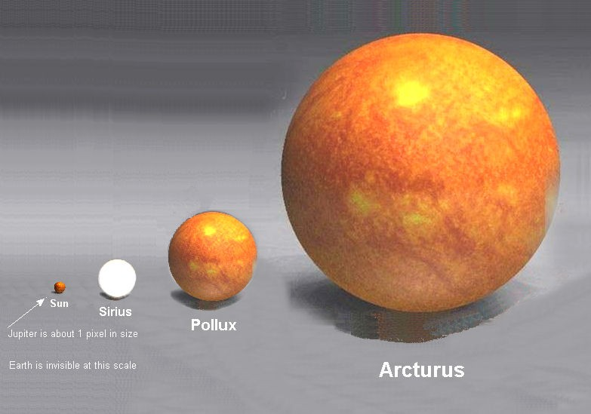

Slide 9
Constellations.
Through the ages people have been intrigued by stars and their patterns.
Give names to these patterns.
Call these patterns constellations.
There are 88 known constellations in the universe.
Orion, southern cross, star sighs etc.

Slide 10
STAR SIGNS
AQUARIUS: 20 JAN – 18 FEB
PISCES: 19 FEB – 20 MARCH
ARIES: 21 MARCH – 19 APRIL
TAURUS: 20 APRIL – 20 MAY
GEMINI: 21 MAY – 20 JUNE
CANCER: 21 JUNE – 22 JULY
LEO: 23 JULY – 22 AUG

Slide 11
STAR SIGNS
VIRGO: 23 AUG – 22 SEP
LIBRA: 23 SEP – 22 OCT
SCORPIO: 23 OCT – 21 NOV
SAGITTARIUS: 22 NOV – 21 DES
CAPRICORN: 22 DEC – 19 JAN

Slide 12
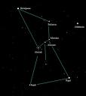

Slide 13
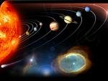
Our solar system

Slide 14
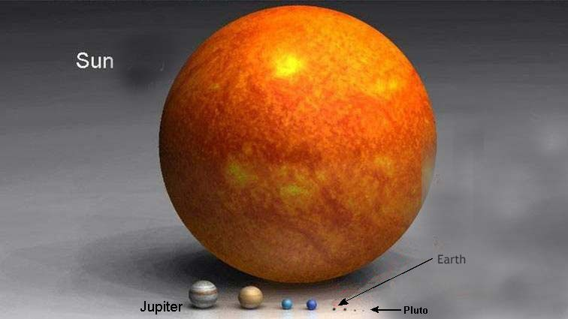

Slide 15
We can only fly on our solar system with a spaceship.
Consists out of 1 star and 9 planets.
The galaxy also has smaller bodies etc: satellites, asteroids, comets and meteoroids.
The moon is a natural satellite, which is made out of rock and orbits around the Earth.
The moon reflects light from the Sun.
The moon don’t have an atmosphere.

Slide 16
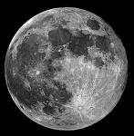
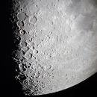
The moon.

Slide 17
Mercury
0 moons
Grey colour

Slide 18
Venus
0 moons
White

Slide 19
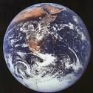
Earth
1 moon

Slide 20
Earth
The Earth move around in its own axe and it take 24 hours. (1 day) 12 hours day & 12 hours night.
The Earth is moving and not the Sun.
The Earth takes 365 ¼ day to orbit around the Earth.
We get our light from the Sun.
Gravity keep us on the Earth.
The Earth has its own atmosphere & water.

Slide 21
Mars
2 moons
Red planet

Slide 22
Jupiter
63 moons –
discovered in 2009
* Brown & pale yellow

Slide 23
Saturn
61 moons
As of 2009
* pale yellow

Slide 24
Uranus
27 mane/moons
Discovered by 2009
Blou-groen kleur /
Blue-green

Slide 25
Neptune
13 moons
Discovered by 2009
Bright blue

Slide 26
Pluto
3 moons
Discovered by 2009

Slide 27
DWARF PLANETS
Sedna , Ceres & Eris

Slide 28
The sun works as a magnet keeping the planets in place.
Every planet orbits around the earth and revolves around its own axes.
Earth axes are not round but oval
The shape is called ellipse.

Slide 29
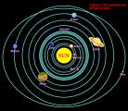
Orbit!
ASTERIOD BELT

Slide 30
DAY & NIGHT
At any given time during the Earth’s rotation around its own axis, half of the Earth is facing the sun and has daylight while the other half is in darkness.
As the Earth turns, the half in daylight moves towards the darkness and nighttime while the half in darkness moves towards the light and daytime.
Remember the Earth turns from West to East.
EXPERIMENT : GLOBE & TORCH
PRESENTATION: DAY/NIGHT

Slide 31
What’s the time?
Imaginary lines run from the North Pole to the South Pole. These are called lines of longitude. They help us to pinpoint locations on the Earth’s surface as well as to determine the time at any given place on Earth.
The Greenwich Meridian is found at 0˚ longitude. There are lines 180˚ east and west of the Greenwich Meridian.

Slide 32
The time is determined by adding one hour to the time at the Greenwich if you move east and subtracting one hour to the time at the Greenwich if you move west. Eg. 5 o’clock in the afternoon in Cape Town and 12 0’clock midnight in Perth.

Slide 33
Solar eclipse (total or not)
Happens when the sun, moon and the Earth are lined up in that order.
The moon’s shadow falls on the Earth causing darkness in the area where the shadow falls.

Slide 34
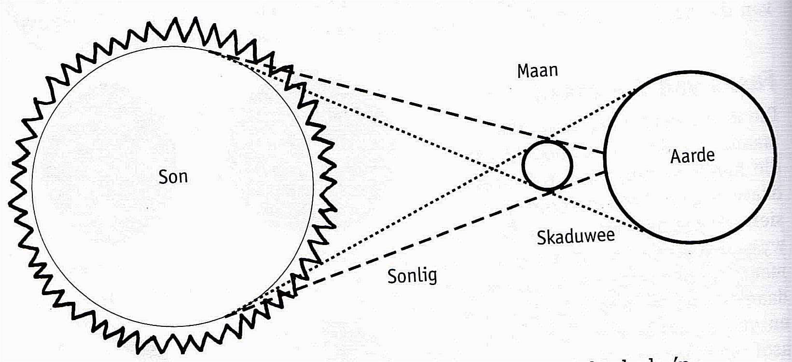

Slide 35
Lunar Eclipse
Happens when the Earth’s shadow falls on the moon.
A partial shadow is known as a Penumbra.
A total shadow is known as an Umbra.

Slide 37
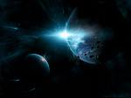

Slide 38
IMPORTANT FACTS:
The Earth move around in its own axe and it take 24 hours. (1 day) 12 hours day & 12 hours night.
The Earth is moving and not the Sun.
The Earth takes 365 ¼ day to orbit around the Sun.
We get our light from the Sun.
Gravity keep us on the Earth.
The Earth has its own atmosphere & water

Slide 39
The sun works as a magnet keeping the planets in place.
Every planet orbits around the Sun and revolves around its own axes.
Earth axes are not round but oval
The shape is called ellipse.
Day & Night: nr 35
What’s the time: nr.38-39
Solar eclipse: nr 41
Lunar eclipse: nr 44
Gr 6: Draw solar & lunar eclipse

